Slide 1
Suppose that you are hired to develop a part of an online banking system. There are three types of accounts. Regular account, savings account and corporate account. Each account has account number and account name. There is no interest for regular account and Interest rate of savings account and corporate account are 3% and 7% yearly. If the balance of a savings account exceeds 10000tk then 150tk will be deduced as TAX.
By implementing maximum code reusability Make required class(es) with necessary attributes and methods considering the above scenario.
Calculate current balance for savings account after 1year while the initial balance was 15000tk.
Ensure data hiding properly while designing your classes.
Write the main method in a separate Main class to create objects of necessary classes and demonstrate their behaviors.

Slide 2
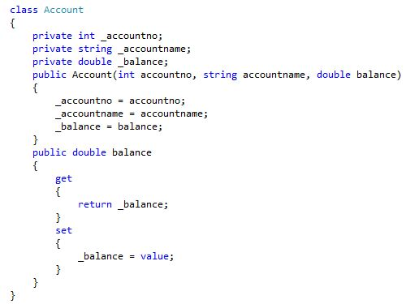

Slide 3
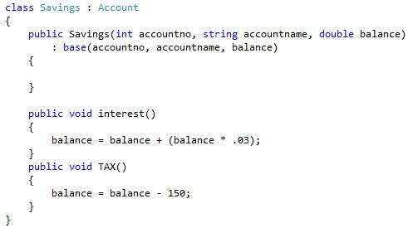

Slide 4
